Slide 1
Social Responsibility & Framework for Business Ethics LECTURE # 2

Slide 2
Fair Use Notice
The material used in this presentation i.e., pictures/graphs/text, etc. is solely intended for educational/teaching purpose, offered free of cost to the students for use under special circumstances of Online Education due to COVID-19 Lockdown situation and may include copyrighted material - the use of which may not have been specifically authorized by Copyright Owners. It’s application constitutes Fair Use of any such copyrighted material as provided in globally accepted law of many countries. The contents of presentations are intended only for the attendees of the class being conducted by the presenter.

Slide 3


What Is Social Resposibility?
Social responsibility is an ethical theory in which individuals are accountable for fulfilling their civic duty, and the actions of an individual must benefit the whole of society. In this way, there must be a balance between economic growth and the welfare of society and the environment. If this equilibrium is maintained, then social responsibility is accomplished.

Slide 4
What it Means to be Socially Responsible and Ethical?
The theory of social responsibility is built on a system of ethics, in which decisions and actions must be ethically validated before proceeding. If the action or decision causes harm to society or the environment, then it would be considered to be socially irresponsible.
Moral values that are inherent in society create a distinction between right and wrong. Every individual has a responsibility to act in manner that is beneficial to society and not solely to the individual.

Slide 5
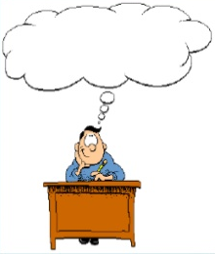
BRAINSTORM:
What would you do if…
You are in a class taking an exam, you are struggling, your teacher turns his back and the student in front of you has the answer sheet available for you to see,
What do you do ?

Slide 6
Questions To Consider From Brainstorm….
Could your decision become habit forming?
Is it legal?
Is it the right thing to do?
Could I defend my actions?
Is it just, balanced and fair?
How will I feel about myself?

Slide 7
When Do Social Responsibility and Ethics Apply?
The theory of social responsibility and ethics applies in both individual and group capacities. It should be incorporated into daily actions/decisions, particularly ones that will have an effect on other persons and/or the environment.
Businesses have developed a system of social responsibility that is tailored to their company environment. If social responsibility is maintained within a company, then the employees and the environment are held equal to the company’s economics. Maintaining social responsibility within a company ensures the integrity of society , company and the environment are protected.

Slide 8
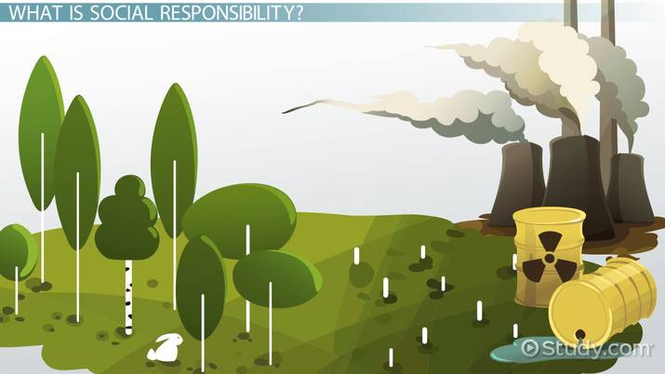
Often, the ethical implications of a decision/action are overlooked for personal gain and the benefits are usually material. This frequently manifests itself in companies that attempt to cheat environmental regulations. When this happens, government interference is necessary.
Unfortunately, social responsibility and ethics are often not practiced by most of the companies, which makes regulation difficult.

Slide 9
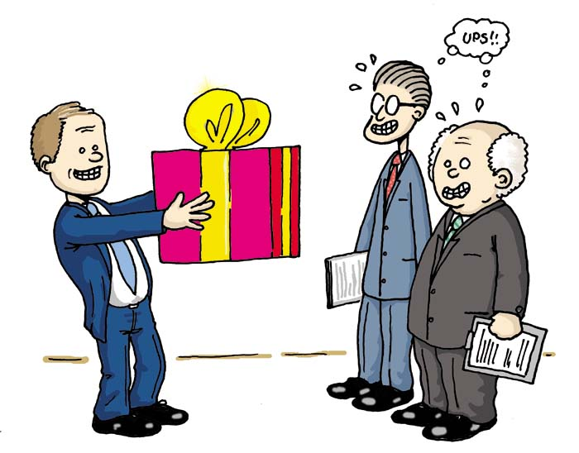
The Nature Of Ethics…
Most Business are guided by business ethics.
When you are guided by ethics, you do not cheat or lie to friends, family of organization.
Different cultures , businesses and industries have different ethical standards.
For Example:
In Thailand, it is customary to exchange gifts during a second business meeting.
Where as:
In China, gift giving is considered a form of bribery and is illegal.

Slide 10

Ethics As Good Business
Many actions make up unethical business practices..
Which includes:
Lying
Offering products known to be substandard
Treating customers or employees unfairly
Many others

Slide 11
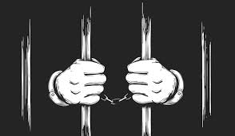

Violation Of Ethical Code
Violating ethical codes of conduct can have many unwanted consequences.
These Includes:
If a business violates government regulations, the owner can be fined or go to jail.
If an employee violates a company or professional code, the employee might be fired or lose his/her job or license.

Slide 12


Conflicts Of Interests
Major ethical question that are generally not illegal.
A conflict between self-interested and a professional obligation.
Example
Hiring a friend over somebody more qualified
Abusing work privileges for personal gain, just because you can.
These are not in the best interest of the company

Slide 13
Brainstorm:
Should student report behavior of other students who are violating the Institution’s ethical code of conduct?
Should employees report behavior that violates ethics policies?

Slide 14
Ethical Questions
When you encounter an ethical decision and must choose a course of action ask yourself these questions…
Is it against the law? Does it violate company or professional policies?
Even in everyone is doing it, how would I feel if someone did this to me?
Am I sacrificing long term benefits for short term gains?

Slide 15


Sources of Ethical Beliefs
1 Basic human values
Reciprocity (Golden Rule)
The Golden Rule (which can be considered a law of reciprocity) is the principle of treating others as one would wish to be treated.
like: with tolerance, consideration, compassion, humanity, etc
self-sacrifice
The giving up of one's own interests or wishes in order to help others or advance a cause.

Slide 16
Sources of Ethical Beliefs (Cont…)
2 Institutional sources
Religion
Philosophy (the study of the fundamental nature of knowledge, reality, and existence, especially when considered as an academic discipline.)
3 Environment
Historical setting
Cultural values

Slide 17
Framework For Studying Business Ethics
Trustworthiness
Be honest.
Don’t deceive, cheat or steal.
Do what you say you’ll do.
Respect
Treat others how you’d like to be treated.
Be tolerant of differences.
Responsibility
Persevere.
Be self controlled and self disciplined.

Slide 18
Framework For Studying Business Ethics (Cont…)
Fairness
Provide equal opportunity.
Be open minded.
Don’t take advantage of others.
Caring
Be kind .
Be compassionate.
Express gratitude.
Citizenship
Contribute to the community.
Protect the environment.
Cooperate whenever feasible.

Slide 19

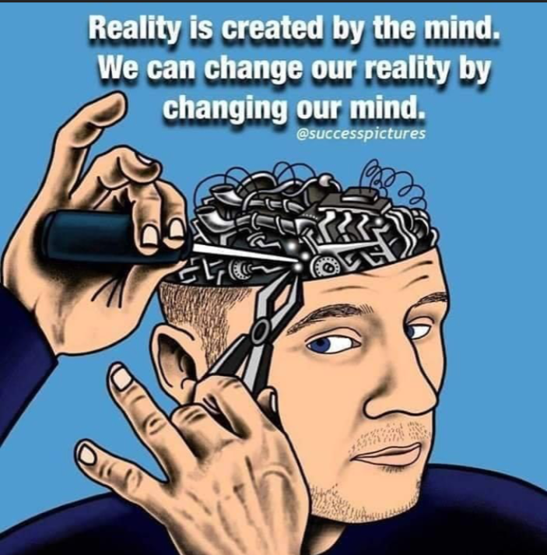


Lesson For Life

Slide 20
Thank you… Questions….??? If Any…

